Slide 1
ID label for products
Each product has an alphabetic ID: from (23714)01 to (23741)27.
Plum rice balls: (01, 02), 03
Salmon rice balls: (04, 05), 06
Tuna rice balls: (07, 08), 09
Sandwiches: (10, 11), 12
Coleslaw: (13, 14), 15
Salad stick: (16, 17, 19
Drinks: (19, 20), 21
Lunch Boxes A: (22, 23), 24
Lunch Boxes B: (25, 26), 27
The ID is printed as barcode.
For details, see the barcode instruction document

Slide 2

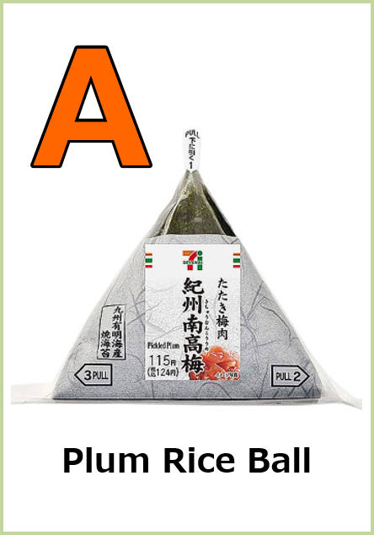
?

Slide 3
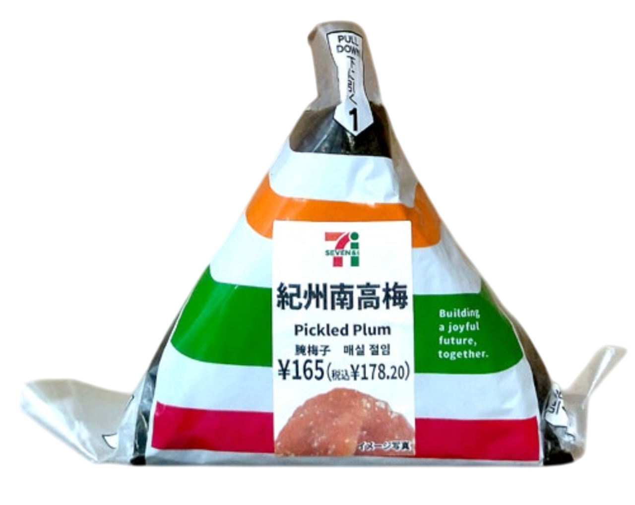
01
02
Plum Rice Ball
Plum Rice Ball
Plum Rice Ball
Plum Rice Ball

Slide 4
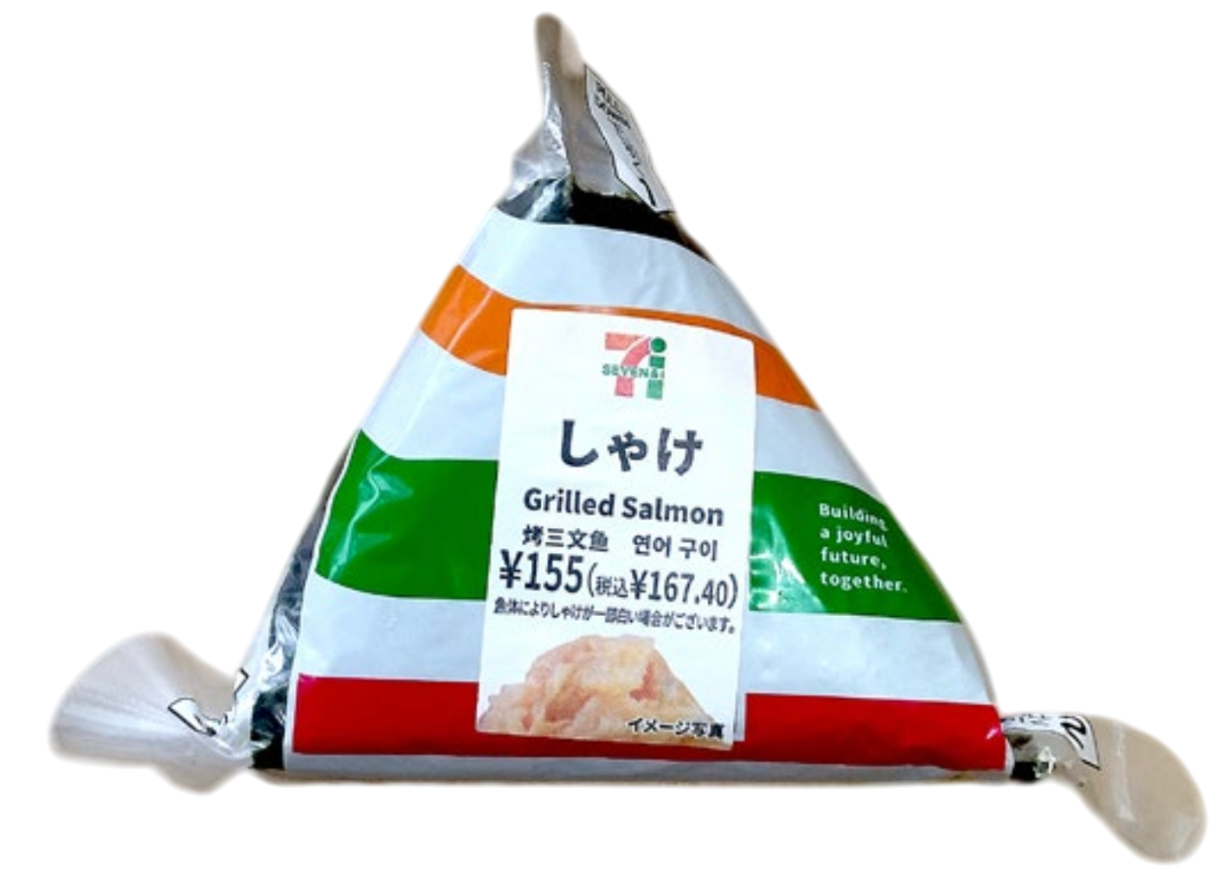
04
05
Salmon Rice Ball
Salmon Rice Ball
Salmon Rice Ball
Salmon Rice Ball

Slide 5
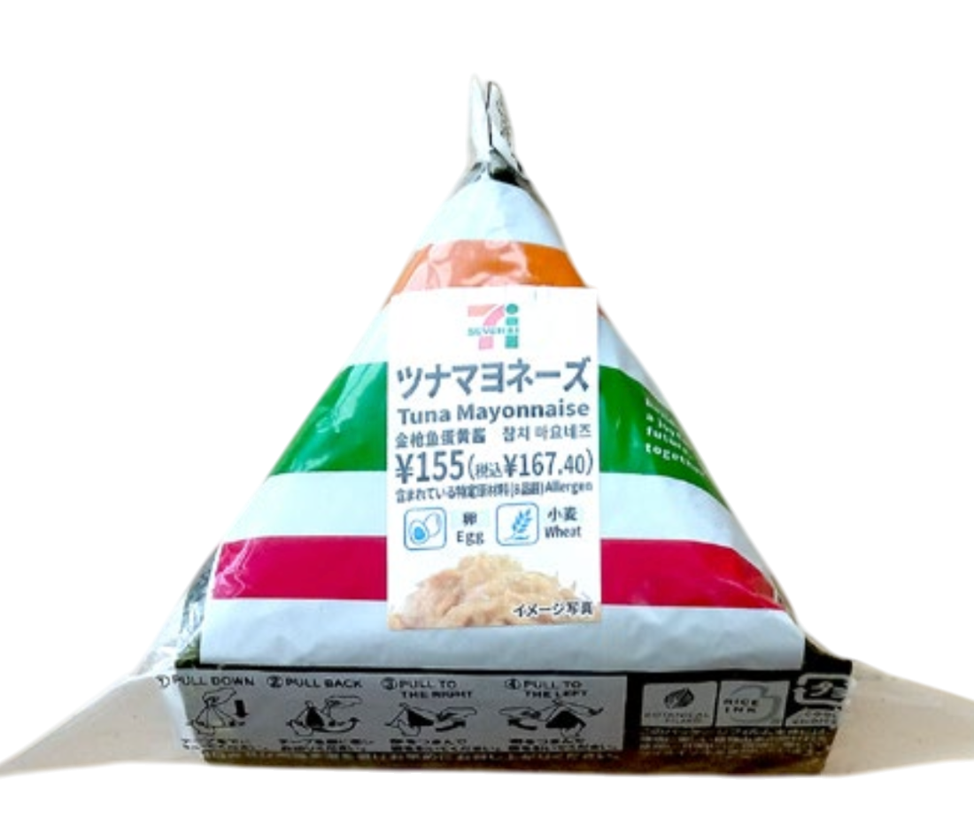
07
08
Tuna Rice Ball
Tuna Rice Ball
Tuna Rice Ball
Tuna Rice Ball

Slide 6
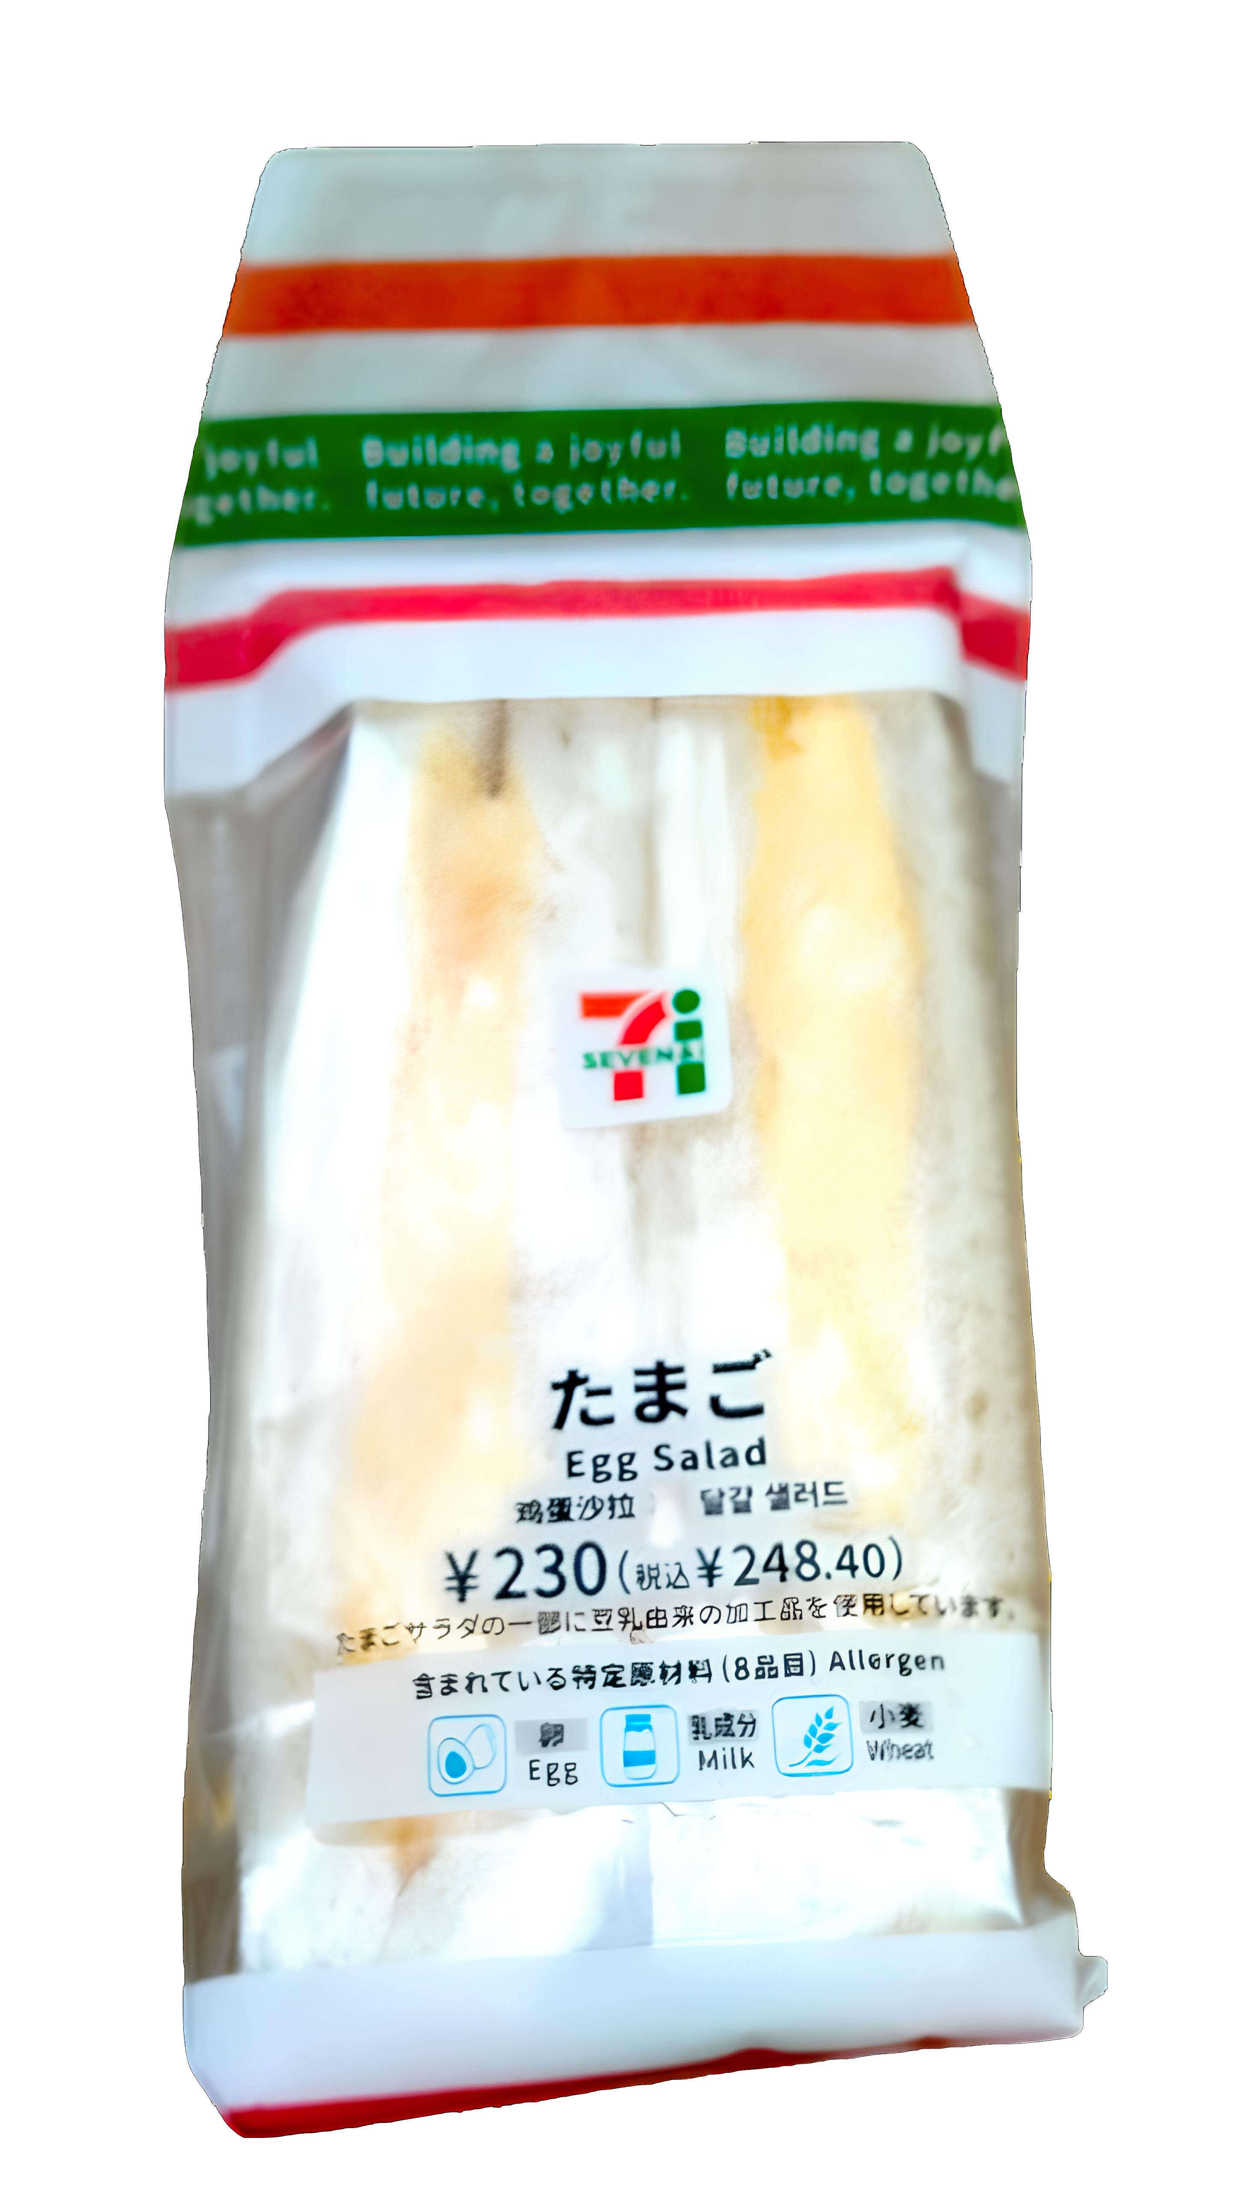
10
11
Egg Sandwiches
Egg Sandwiches
Egg Sandwiches
Egg Sandwiches

Slide 7
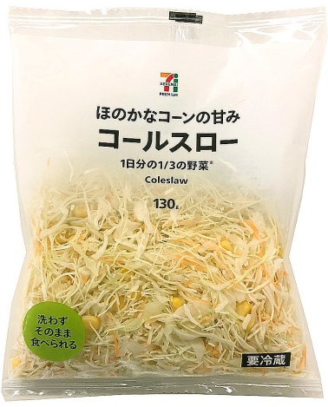
13
14
Coleslaw
Coleslaw
Coleslaw
Coleslaw

Slide 8
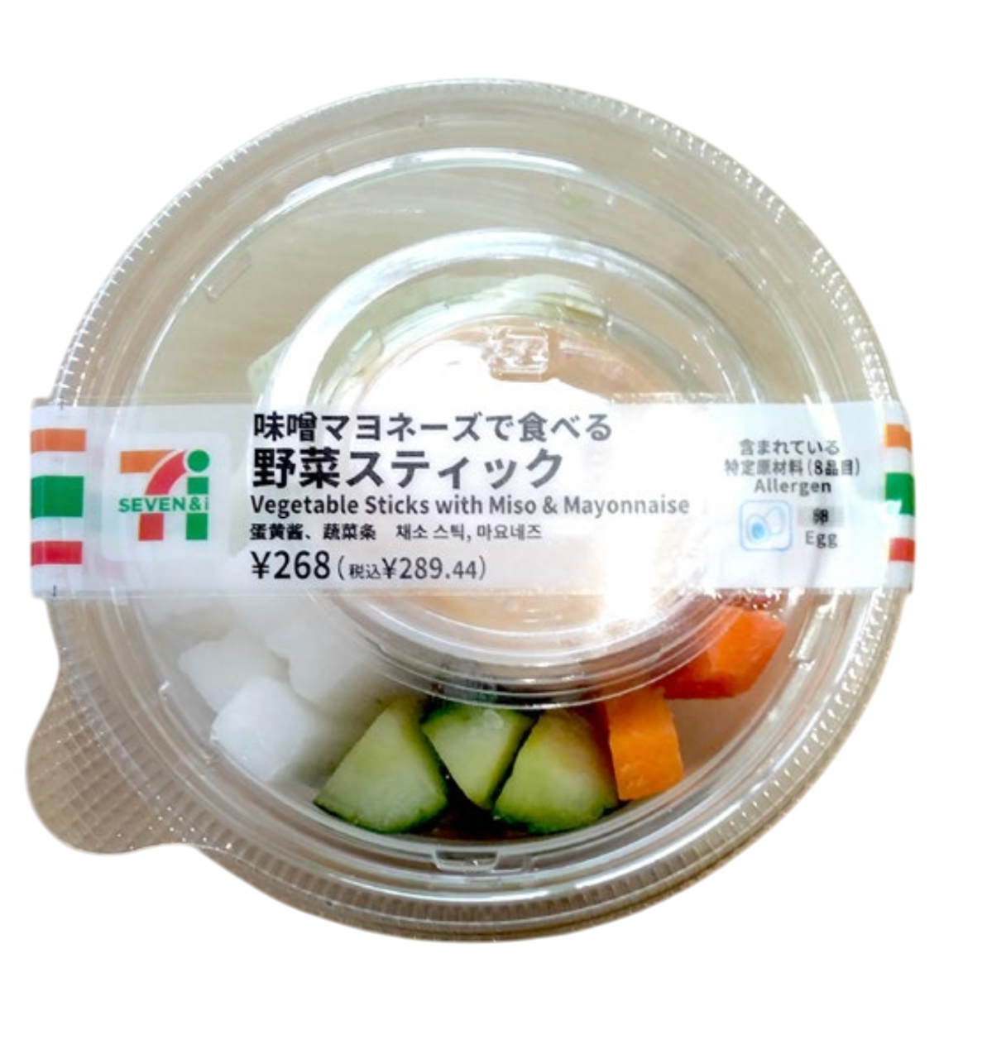
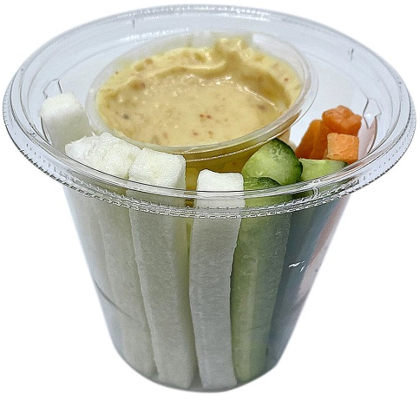
16
17
Stick salad
Stick salad
Stick salad
Stick salad

Slide 9

19
20
Packed drink
Packed drink
Packed drink
Packed drink

Slide 10
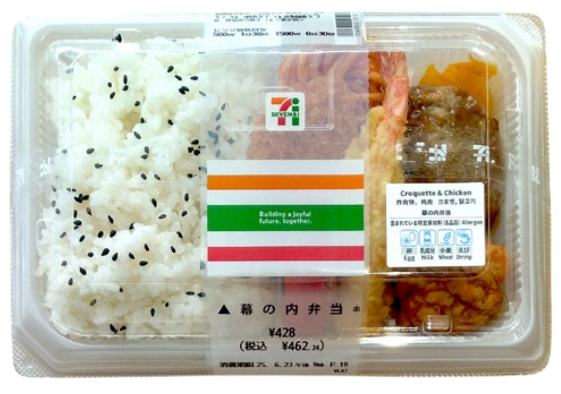
22
23
Lunch Box 1
Lunch Box 1
Lunch Box 1
Lunch Box 1

Slide 11
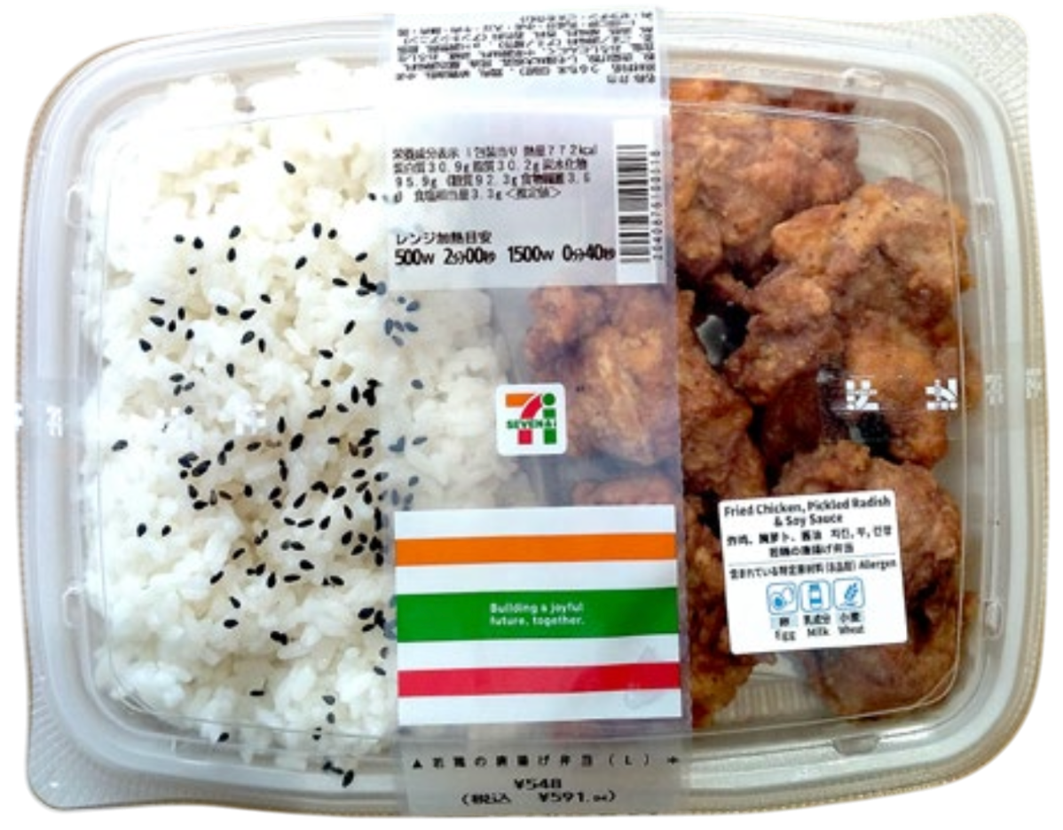
25
26
Lunch Box 2
Lunch Box 2
Lunch Box 2
Lunch Box 2

